Slide 1


A MODEL TO PREDICT IF CUSTOMERS OF SYRIATEL STOP USING THEIR SERVICES
BREDEN MUGAMBI

Slide 2
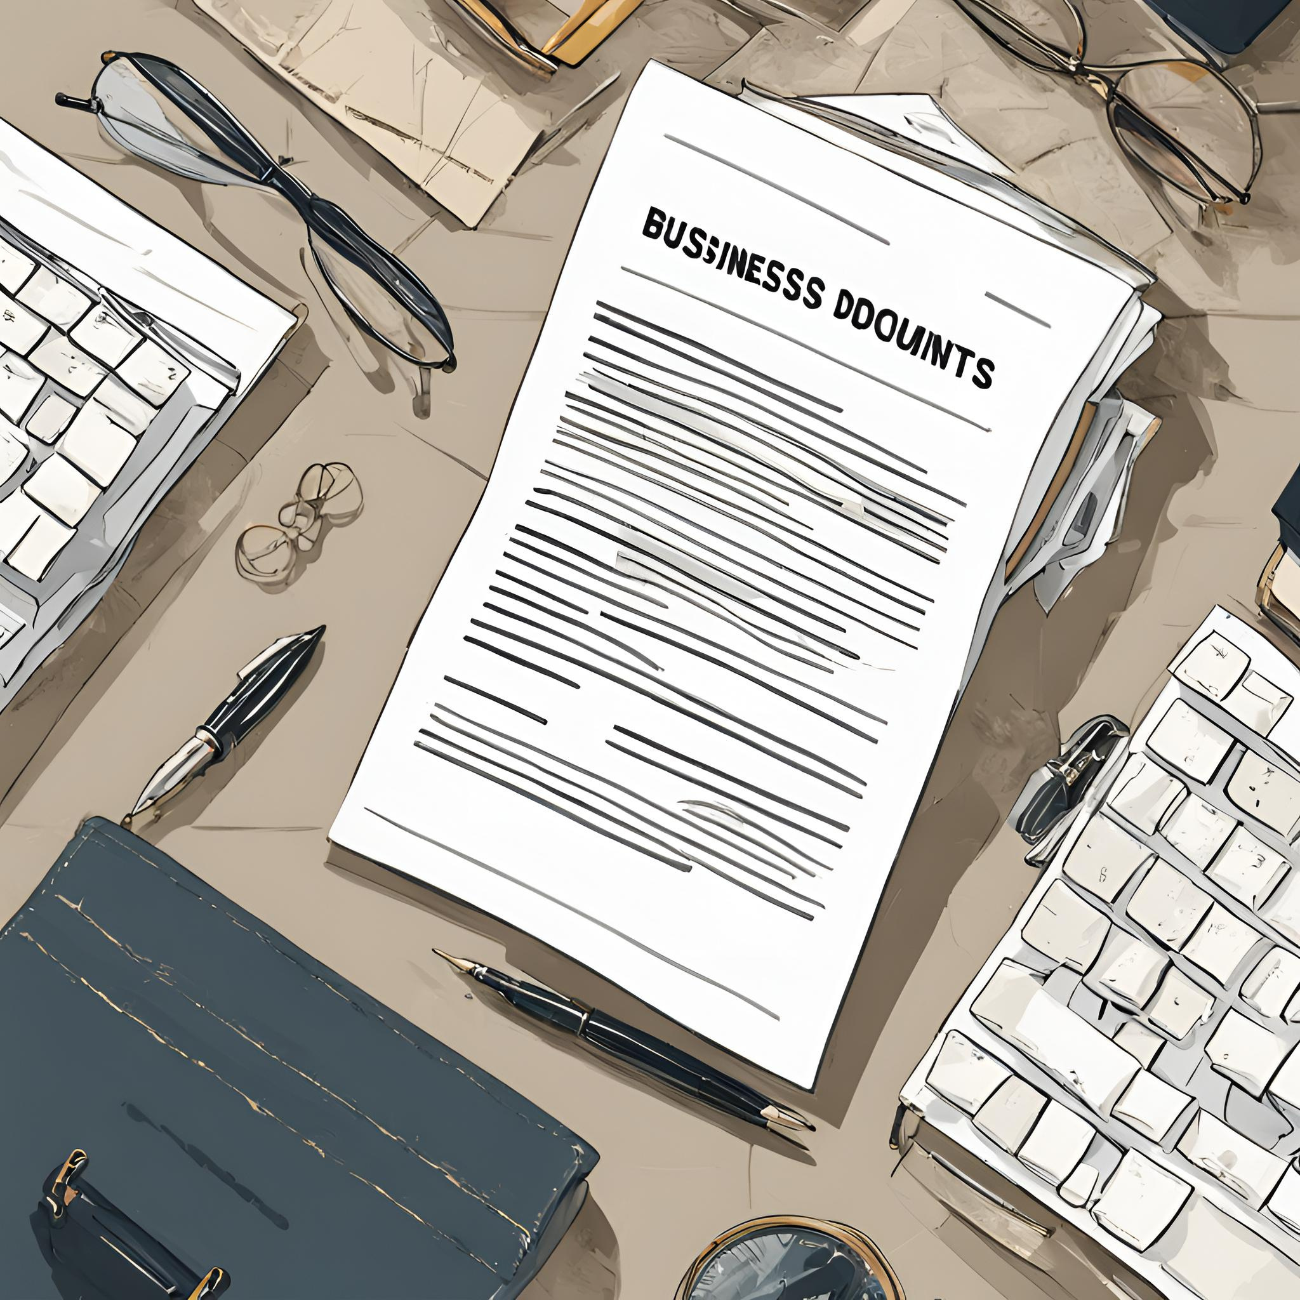

Overview
This project aims to develop a machine learning model to predict customer churn for Syriatel, a telecommunications company. The model will identify customers at risk of discontinuing their services, allowing Syriatel to implement targeted retention strategies and improve customer lifetime value.

Slide 3

BUSINESS UNDERSTANDING
SyriaTel faces a critical issue: customer churn. Subscribers discontinuing service leads to lost revenue and hinders the company's growth. To address this challenge, a comprehensive customer churn prediction model is proposed. This model will analyze customer data to identify those at high risk of churning. By recognizing these at-risk customers through predictive analytics, SyriaTel can take proactive measures to address their concerns and needs.

Slide 4
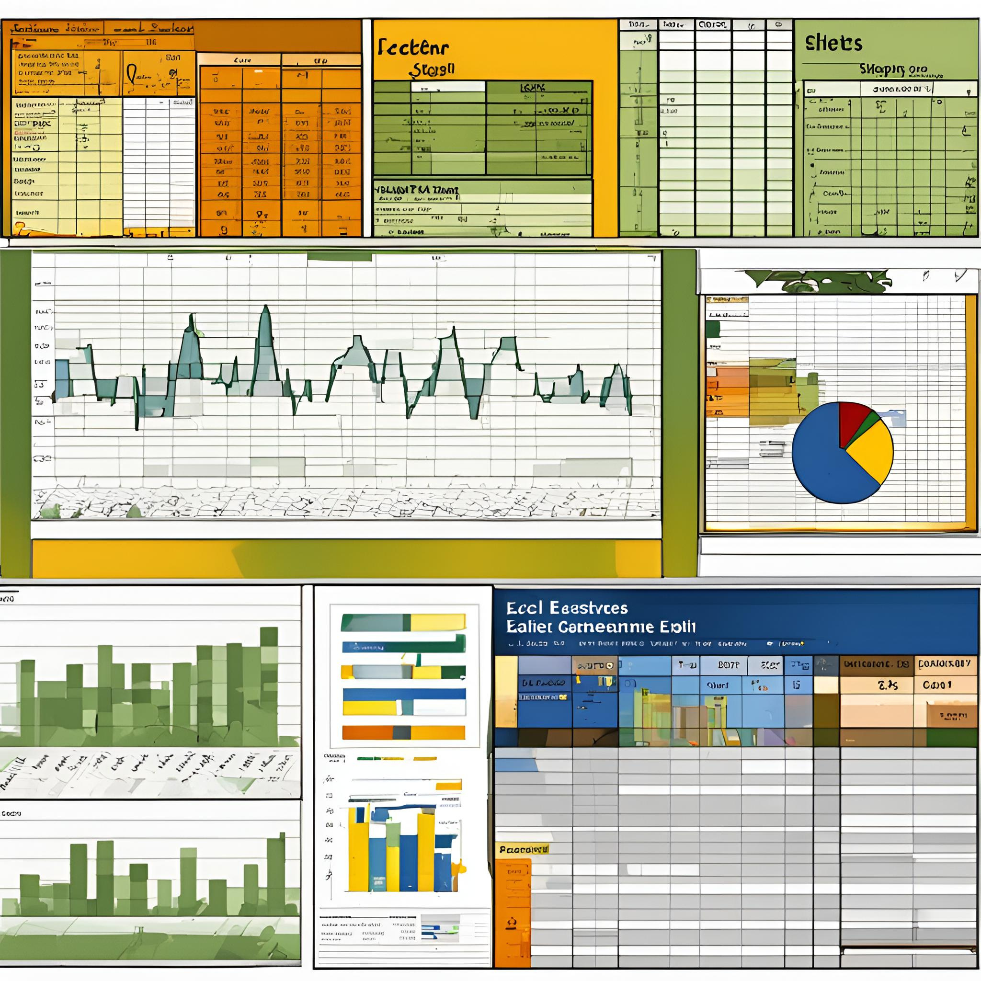

DATA UNDERSTANDING
The Dataset was acquired from Syriatel, a Telecommunications company. It contains 3333 rows and 21 columns, with the columns each having unique distinct names
It contains various co.umns such as total day calls, number of voice mail messages, and churn, the probability of a customer stop using their services

Slide 5
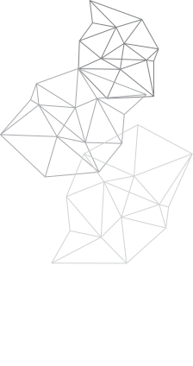
MODELLING
We have 3 models: a decision tree, random forest , and a tuned version of a decision tree
The reason for using decision trees and random forest is because they are more efficient in binary classification problem, which our problem is
this involves taking the data, separating it into training and testing sets, and using our model on the sata to predict our values.
Ater its done, we do this on all 3 models to see if there is any improvement

Slide 6
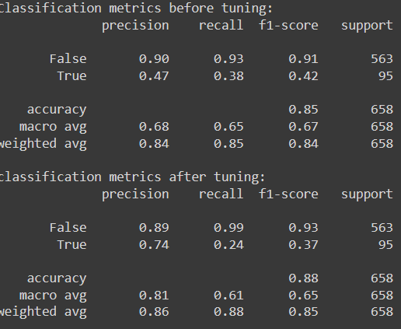
EVALUATION
With the decision trees, there is an accuracy of 84 oercent while with a tunedd decision tree there is an accuracy of 88%. This shows that there is signigficant improvent with the model after tuning
This shows that the model has efficiently predicted results

Slide 7

RECOMMENDATIONS
POSSIBLE RECOMMENDATIONS INCLUDE:
ADVERTISING FOR DAY CUSTOMERS - AS THEY ARE THE ONES WHO ARE MORE LIKELY TO STAY
INCENTIVIZE MORE PEOPLE TO USE THE SERVICE FOR LONG AS THE LONGER THE MINUTES SPENT ON THE CALL, AND THEREFORE THE SERVICE, LEADS TO MORE RETENTION
PERSONALIZED OFFERS, IN THAT THERE WILL BE A HIGHER RETENTION OF CUSTOMERS AS THEY WILL FEEL THAT THE COMPANY IS CATERING TO THEIR NEEDS

Slide 8
NEXT STEPS
Cost-Benefit Analysis - Examine the expenses associated with putting these suggestions into practice and weigh them against the possible income increases from client retention.
A/B Testing - Use A/B testing to put selected strategies into practice, assess their efficacy, and identify which ones connect the most with the stakeholders

Slide 9





CONTACT
linked.com/Mugambi
breden.mugambi@student.moringaschool.com
254 701 994293

